Slide 1
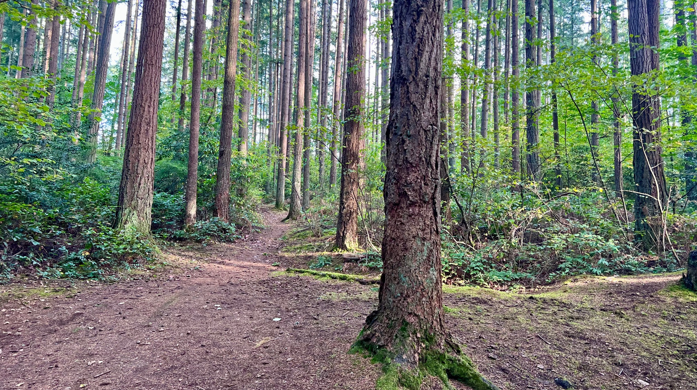
Juanita Woodlands Trail Update
February 2024
Kelly Heintz
Kelly.Heintz@kingcounty.gov

Slide 2
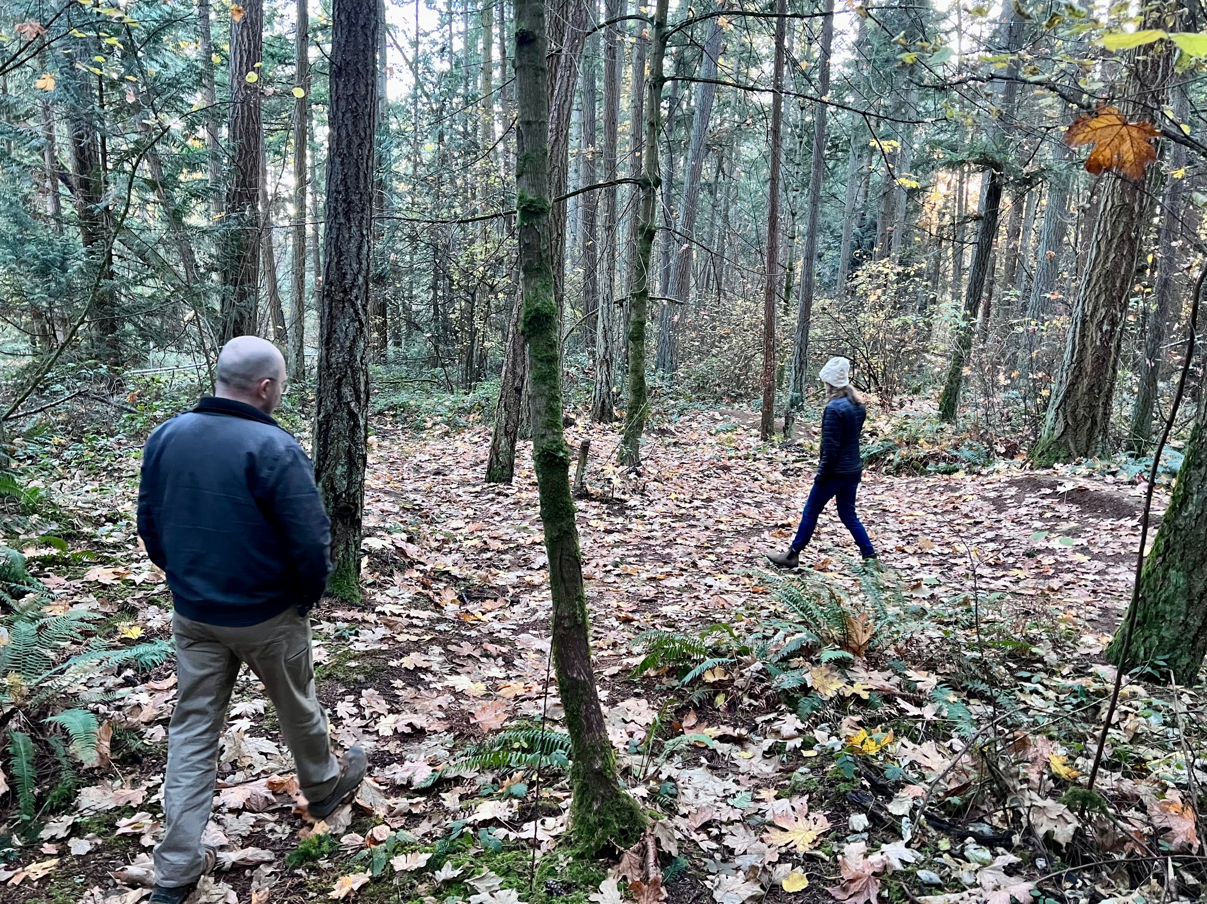
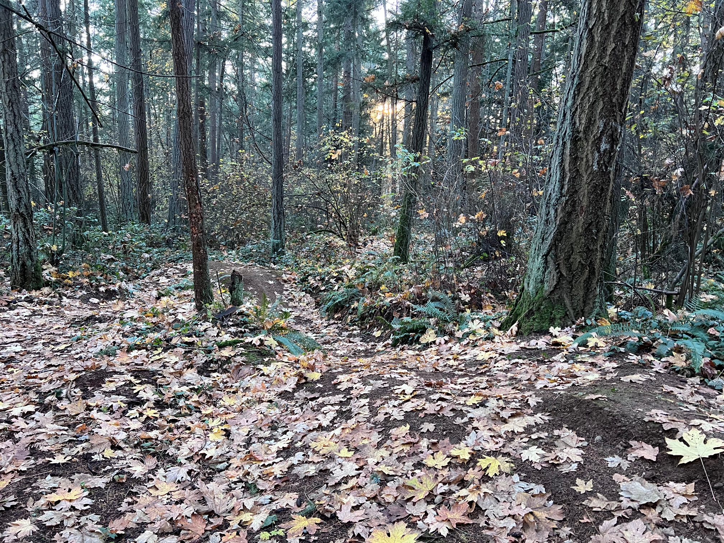
Overview of 2024-2025 Work
Upcoming trail realignments and limited permanent closures
Addressing trail redundancy and protecting habitat (e.g. removing old unauthorized mountain bike trail)
WA Trails Association will conduct work in Summer/Fall 2024
Volunteer opportunities – Winter '24/ Spring '25
Please help us by 1) respecting trail closures 2) join us at a volunteer work party in 2025.
Existing redundant trail system
Existing unauthorized bike trail

Slide 3
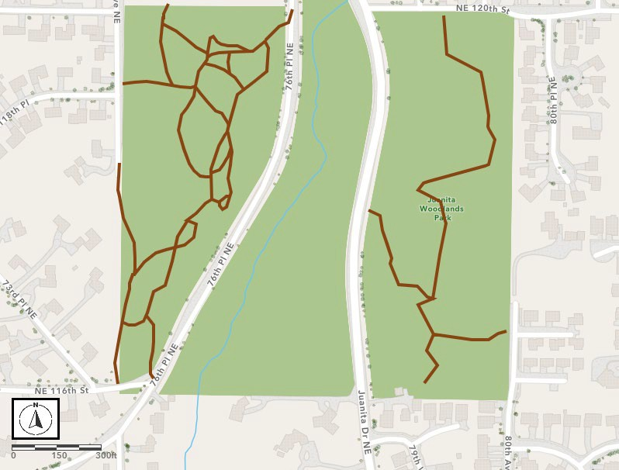
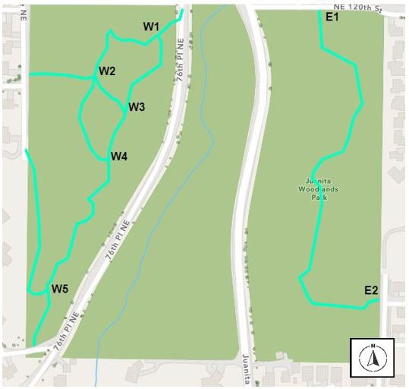
Juanita Woodlands Current Trail System
Juanita Woodlands Proposed Trail System

Slide 4
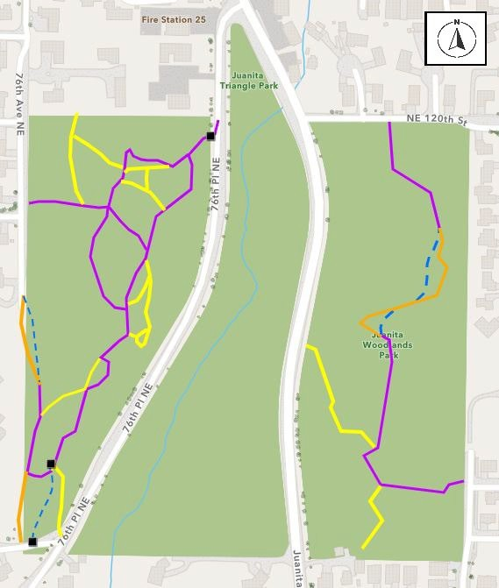
JUANITA WEST
Current: 1.01 miles of trail
Decommission/Restoration: 0.36 miles
Re-route: 0.12 miles
Trail Mileage Total: 0.8 miles
JUANITA EAST
Current: 0.42 miles of trail
Decommission/Restoration: 0.21 miles
Re-route: 0.08 miles
Trail Mileage Total: 0.29 miles
Retain Trail
Realign Trail
Decommission
Concept Alignment Structure Needed

