Slide 1
2044 Comprehensive Plan Update
September 18, 2024 | Finn Hill Neighborhood Alliance
Notes:
40 slides

Slide 2
Sustainability, Climate, & Environment Element – K2044 Highlights
Address climate change impacts
Address heat and smoke events with an equity lens to increase resilience
Promote electrification of the community
Provide education on sustainability topics
​
Notes:
The Community is looking for solutions to help Kirkland will have the direction to achieve its climate goals. They want to do this with trackable initiatives and programs that do this equitably and focus on concepts such as electrification and want the city to lead and educated the community to ensure that future generations enjoy Kirkland as they have done.

Slide 3


Parks Element - K2044 Highlights
Prioritize underserved communities
Explore innovative solutions to provide parks & recreational opportunities in denser areas
Create new public access to Lake Washington shoreline
Improve Americans with Disabilities Act (ADA) accessibility at City parks and recreation facilities
Preserve and enhance the tree canopy in parks
Incorporate sustainability initiatives and parks & recreation facilities

Slide 4
Economic Development Element –K2044 Highlights
Increase amount of affordable commercial rent spaces
Promote “third places” for economic activity
Support diversity of businesses and other DEIB goals
Allow small-scale commercial in residential neighborhoods (e.g., neighborhood-oriented corner stores)
Flexible home-based businesses code amendments
Promote entrepreneurship; pop-up commercial spaces; activate parks w/businesses
Notes:
-Align with Sustainability Strategic Plan and HB 1181 new GMA Climate Goals for businesses and city
-Add performance measures to track economic activity; priority population businesses and demographics

Slide 5
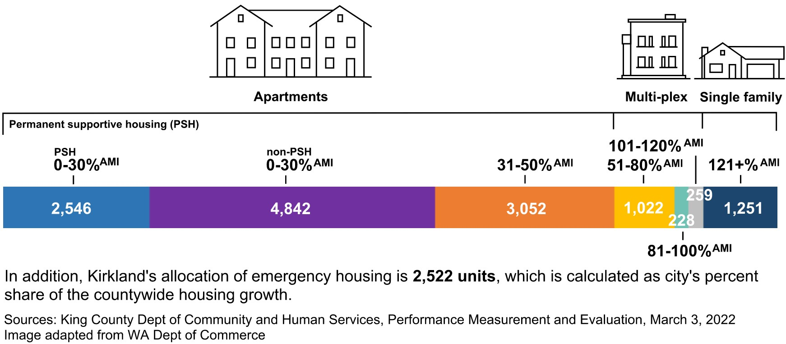
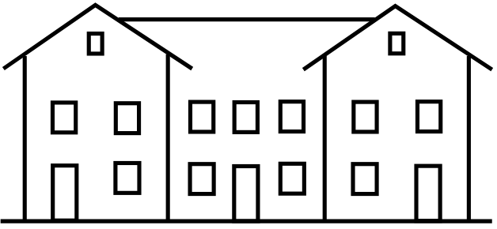
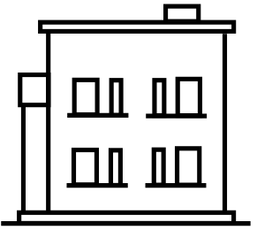
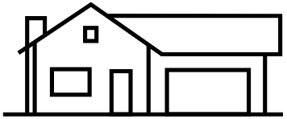
Kirkland’s 2019-2044 Housing Needs Allocation
13,200 Net New Units
10,440 Apartments (79%) for households making 0-50% AMI
1,509 Multi-plex (11%)for households making 51-120% AMI
1,251 Single family (10%) for households making +120% AMI

Slide 6
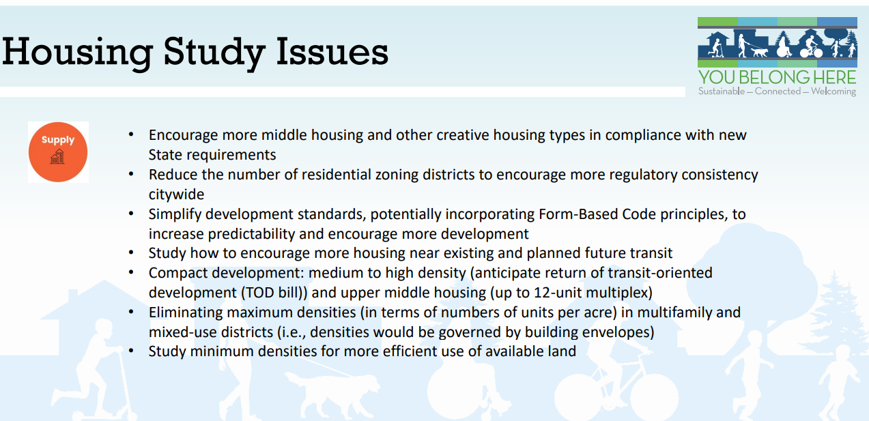

Slide 7
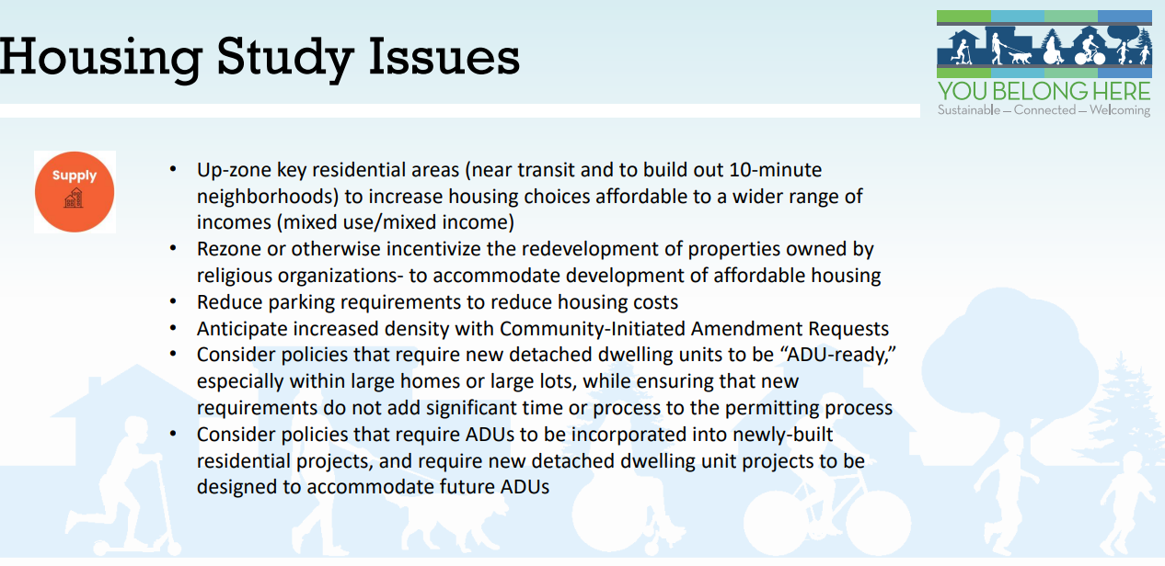

Slide 8
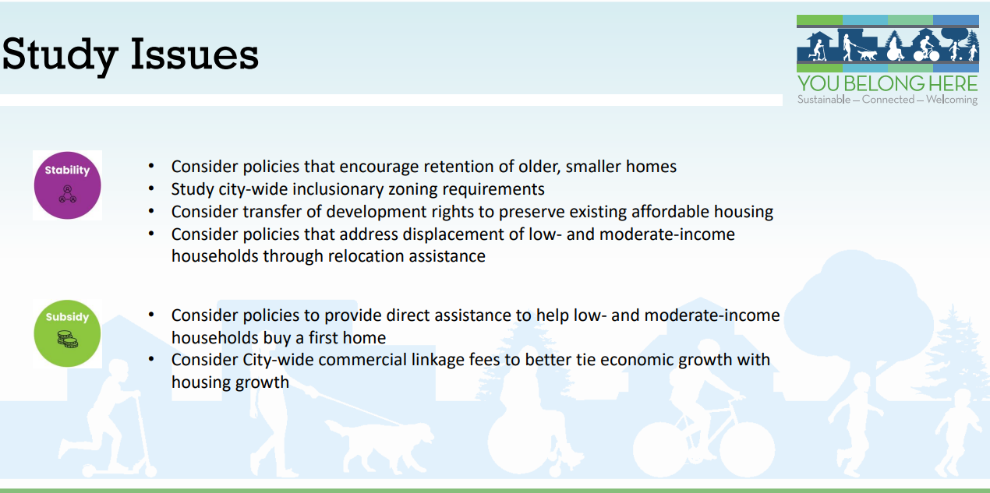

Slide 9
Land Use –K2044 Highlights
Promoting affordable housing citywide
Stimulating production of middle housing types
Consolidating zoning districts to support more uniform development regulations
More allowances for small-scale neighborhood commercial uses and home-based businesses
Explore reducing and/or restricting parking requirements
Incorporating State requirements
Streamlining permit reviews and the design review process

Slide 10
Where are we at in the adoption process for the Land Use Element?
Public hearing opened on May 23, 2024. PC voted to continue the hearing and keep record open for written testimony.
Public hearing continued on June 13, 2024. PC voted to continue the hearing again AND re-open the public record for spoken testimony.
Public hearing continued on August 22, 2024 for verbal comment.
Planning Commission made their recommendation on the Land Use Element on September 12, 2024.
Planning Commission will discuss their recommendations with City Council at a joint study session on October 15, 2024.
Council will consider adoption of the Land Use Element with the full Comprehensive Plan on December 10, 2024.

Slide 11
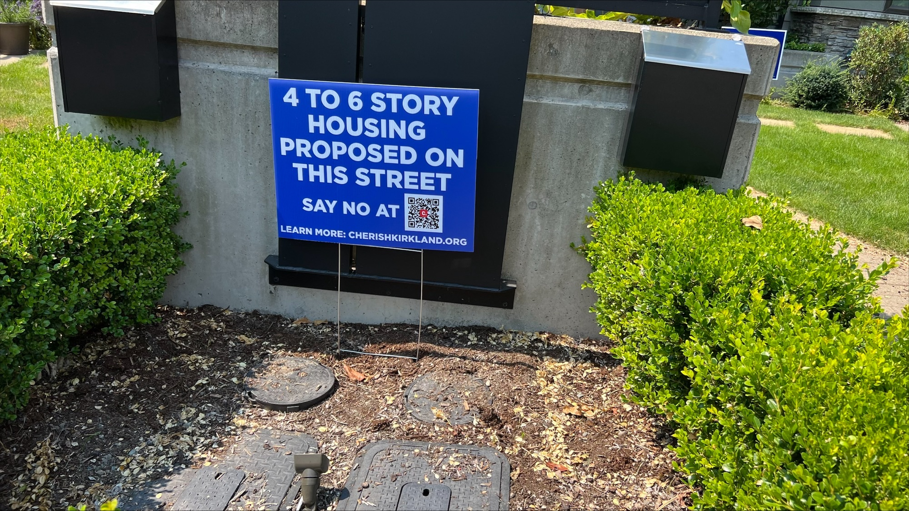

Slide 12
Existing Comprehensive Plan Policy
(2035 Plan)
Policy LU-3.4: Focus Locate higher density land uses primarily in areas served by frequent transit service.

Slide 13
Current Status of “Transit Corridor” Policy
On September 12, 2024, Planning Commission deliberated and voted on a recommendation to City Council for the complete Land Use Element of the Comprehensive Plan.
Planning Commission voted to remove LU-2.4 from their recommended version of the Land Use Element.
Planning Commission also voted to remove transit corridor overlays from the recommended Land Use Map.
Planning Commission added one new policy to the element:
  Policy LU-2.#: Expand access to housing by growing Kirkland's regional growth centers and neighborhood commercial centers, areas that have potential to be 10-minute neighborhoods, and areas within a 0.5 mile walk of full-service grocery stores.

Slide 14
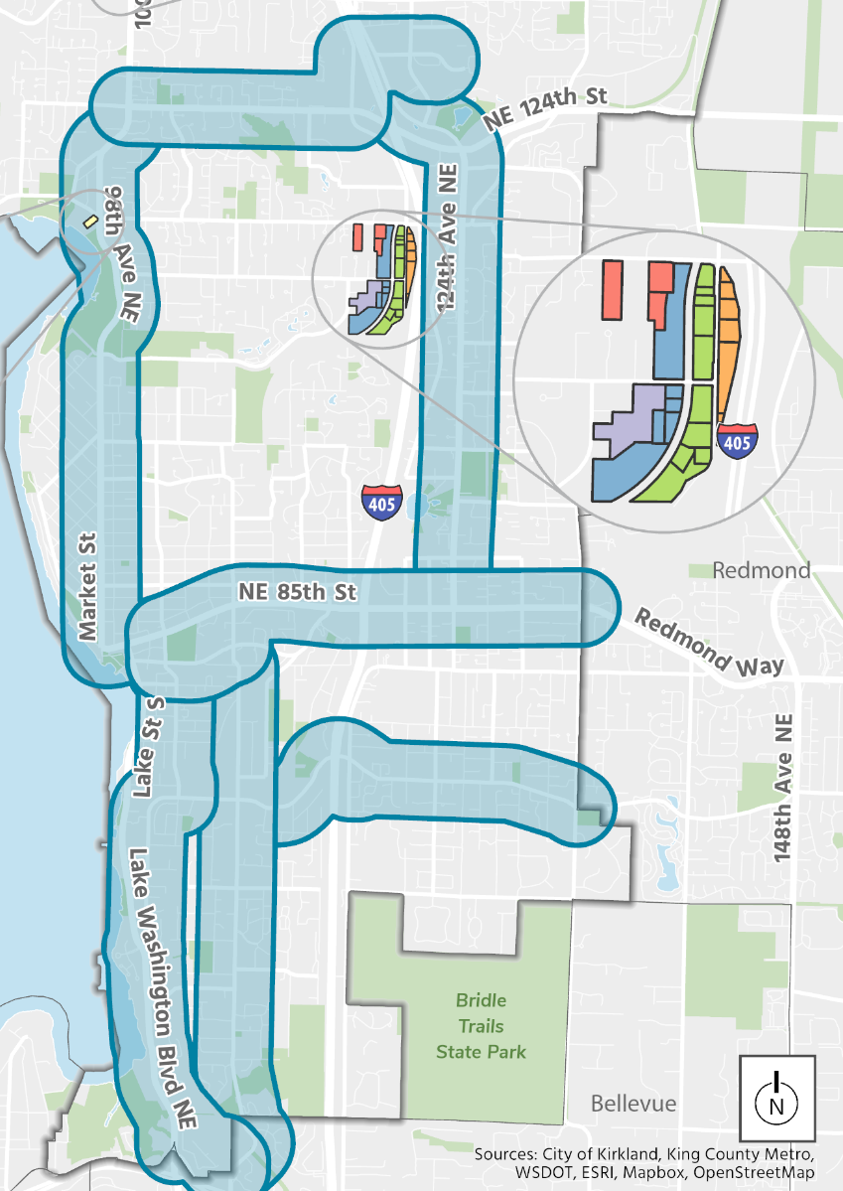
Analyzed Frequent Transit Corridors
1
Provide “high-bookend” for analysis in Supplemental Environmental Impact Statement (SEIS)
¼ mile buffer
1 | 100th Ave NE to Totem Lake Transit Center (NE124th St/NE 128th St)
2 | 6th St S to 132nd Ave NE (NE 68th St/NE 70th Pl)
3 | Downtown Transit Center to 132nd Ave NE (Central Way/NE 85th St)
4 | Downtown Transit Center to 100th Ave NE (Market St)
5 | Downtown Transit Center to S Kirkland Park & Ride (NE108th Ave NE/6th St/98th Ave NE)
6 | Downtown Transit Center to S Kirkland Park and Ride (Lakeview Dr/Lake Washington Blvd NE)
7 | NE 85th St to Totem Lake Transit Center (124th Ave NE/Totem Lake Blvd)
7
4
3
2
6
5

Slide 15
Draft Policy LU-2.4* (last version presented at public hearing)
Policy LU-2.4: Explore additional capacity for higher-intensity residential uses along identified frequent transit corridors once the NE 85th St Station Area residential development has achieved a number of residential units with vested permits equal to the affordable housing pioneer provision, and ensure development regulations enable diverse housing options and small-scale retail and commercial opportunities. Evaluation of this additional capacity should occur pursuant to the framework established below:
Prioritization. Increases to capacity near frequent transit corridors should be considered individually per transit corridor segment, and should be studied in the below priority order per discrete tasks adopted in the Planning Work Program:
Tier 1 (top priority): Bus Rapid Transit lines with dedicated funding for implementation (e.g., K Line and STRIDE Line).
Tier 2 (secondary priority): Tier 2 capacity increases should be studied pursuant to the following priorities:
    Transit corridors with existing frequent service (15-minute headways or less during commute hours) that travel through or connect the City’s Regional Growth Centers.
    Transit corridors with existing frequent transit service that do not travel through or connect the City’s Regional Growth Centers if new transit service is funded beyond 2024 service levels.
*Policy not included in Planning Commission recommendation to City Council.

Slide 16
Draft Policy LU-2.4 * (Continued)
Public Process. Evaluating additional capacity pursuant to Policy LU-2.4 would be conducted pursuant to the provisions of Process IV described in Chapter 160 of the Kirkland Zoning Code (i.e., ultimate decision by City Council based on a Planning Commission recommendation) and would take the form of Zoning Code/Map amendments. The process would involve the following steps:
  The process will be initiated through the inclusion into the Planning Work Program of study of one or more transit corridors for increased capacity. The Planning Work Program extends over three years and is approved annually by the City Council based on a Planning Commission recommendation.
  Conduct environmental review pursuant to the State Environmental Policy Act (SEPA) analyzing the specific environmental effects of each proposal. While the Supplemental SEIS prepared for the Comprehensive Plan will be the foundation for the environmental review, supplemental environmental review will be conducted to evaluate potential environmental impacts at the corridor scale – including impacts on transportation infrastructure, public services, schools, and utilities. Other technical studies may be needed to support this analysis, such as a corridor study.
  Conduct public outreach, including meetings with established organizations and individuals representing the City’s diverse community and interests.
  Undertake noticing of each zoning proposal, as required in the Zoning Code, and including at least two public notice signs along each corridor proposed for rezoning.
  Staff will prepare staff reports outlining possible rezoning options, which will be presented to Planning Commission in at least one study session and in advance of a public hearing. Additional capacity should only be granted after sufficient technical analysis in support of additional capacity has been completed, and there are assurances (e.g., dedicated funding) that adequate infrastructure capacity will be in place to support additional density.
  A public hearing will be held for each proposal.
  After the public hearing, the Planning Commission will make a recommendation to City Council on each rezoning proposal, and City Council will decide whether to adopt.
*Policy not included in Planning Commission recommendation to City Council.

Slide 17
Draft Policy LU-2.4* (Continued)
Decisional Criteria. In determining the geographic boundaries of any zoning amendments, and associated maximum building heights, densities, and other changes to development regulations, the following criteria should be taken into account:
  Existing and planned multimodal infrastructure and transit service to accommodate density.
  Existing and planned parks and open spaces (public and private).
  The ability of the change to expand the City’s supply of affordable housing.
  School capacity to accommodate added density.
  Street safety for all modes.
  A gradual transition of intensity with the highest intensity uses located closest to the center of the corridors and the lowest intensity uses located at the outer edges of the corridors.
  The need for sufficient grocery, commercial, and retail services to enable a complete community centered on the key transit corridors.
  The extent to which the capacity increase promotes 10-minute neighborhoods.
*Policy not included in Planning Commission recommendation to City Council.

Slide 18
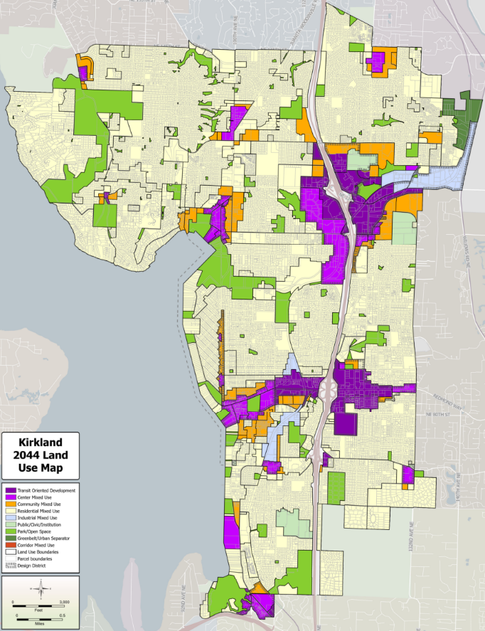
Draft Land Use Map – Without Transit Corridor Overlays

Slide 19
Capacity Analysis Results: Citywide
Summary of Kirkland Capacity Analysis | Housing Units | Employment
2044 Growth Targets | 13,200 | 26,490
Existing Comprehensive Plan/Zoning
Surplus Capacity for 2044 Above Growth Targets* | 6,234 | 858
2044 Comprehensive Plan + Potential Land Use Changes
Kirkland Surplus Capacity for 2044 Above Growth Targets* | 24,862 | 15,005
*Difference between Kirkland totals for 2044 (based on 2022 existing) and King County total targets for 2044 (based on 2019 existing)

Slide 20
What are steps to implement Comprehensive Plan policies?
1. Adopt policy as part of the Comprehensive Plan Update
3. Craft Zoning Code amendments with extensive public process (timing determined by Planning Work Program)
2. Schedule Zoning work as part of the 3-year Planning Work Program (updated annually)
Comprehensive Plan policies establish direction for:
Future projects that could amend the Zoning Code.
Areas of the City that are generally appropriate for additional residential and jobs capacity.
Priorities for the future (e.g., where opportunities for more housing/jobs should be focused, and how uses should interact).
For timing of implementation, we ask:
Are there any prerequisite projects or conditions that should occur before specific projects (e.g., Zoning Code/Map changes)?
Where does each project rank in priority amongst other planning tasks?
For timing of future Zoning Code amendments, we:
Begin with framework in Comprehensive Plan to scope analysis;
Complete parcel-specific analysis of any potential rezone areas;
Complete State Environmental Policy Act (SEPA) review;
Complete additional technical analysis (e.g., traffic analysis), if needed;
Conduct public engagement and public legislative amendment process with public, Planning Commission, and Council.
Project level SEPA review is triggered for developments with more than 20 units.

Slide 21
Remaining Public Meeting Schedule
September 26, 2024: Planning Commission Public Hearing
Housing Element
Appendix (Community Profile, Glossary, History Narrative)
October 15, 2024: Joint City Council/Planning Commission Study Session
Planning Commission K2044 Recommendations
December 10, 2024: Council Adoption
Attend the Open House at City Hall!
4:00 – 5:30 PM.
​

Slide 22
Comprehensive Plan Questions?

